Slide 1
A Space for Justice: messianic time in the figures of the IPCC
Elizabeth Callaway
Department of English
UCSB

Slide 2
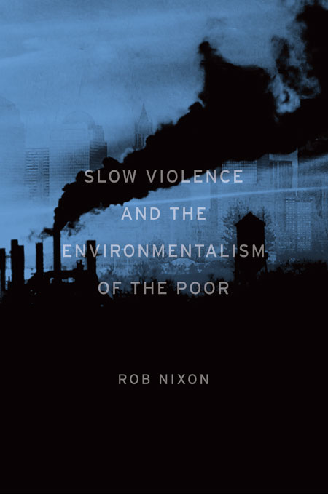
“Climate change and a host of other slowly unfolding environmental catastrophes present formidable representational obstacles that can hinder our efforts to mobilize and act decisively” (Nixon 2).

Slide 3



Slide 4
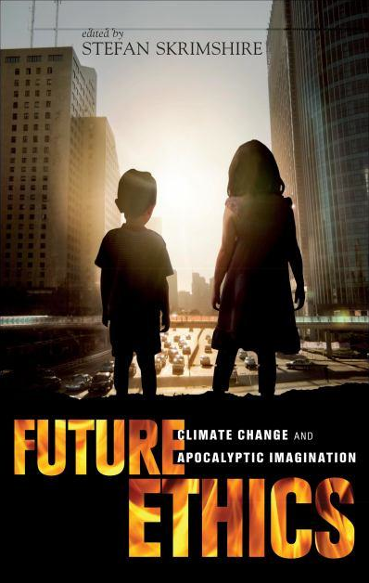
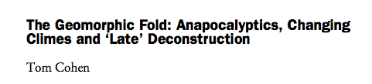
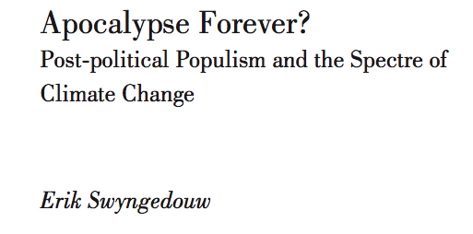
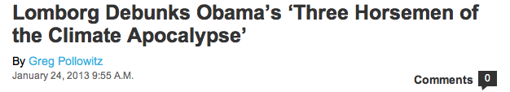

Slide 5
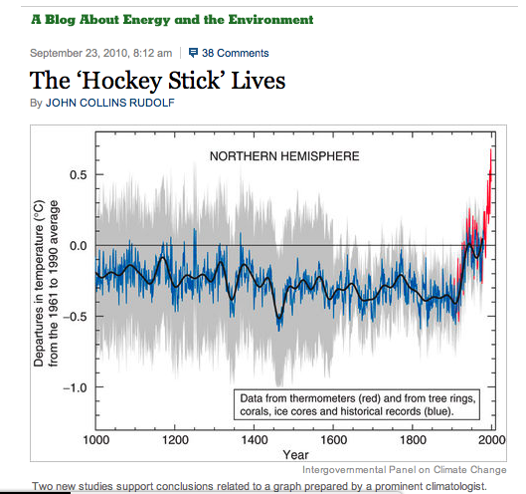
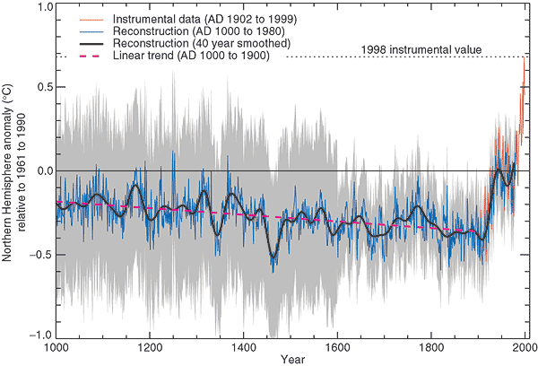
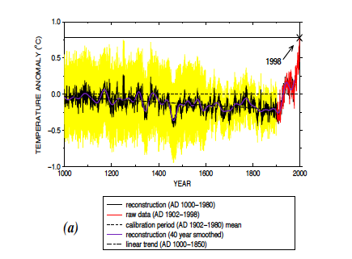
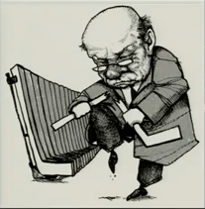
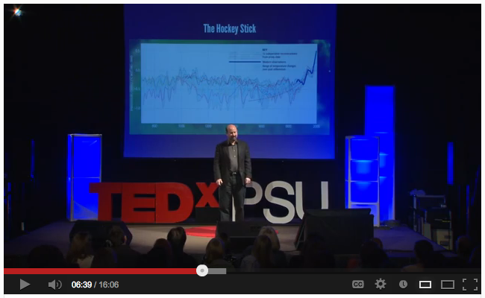
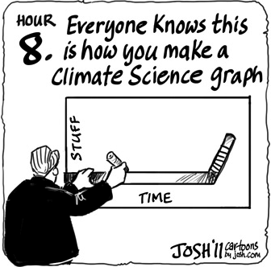
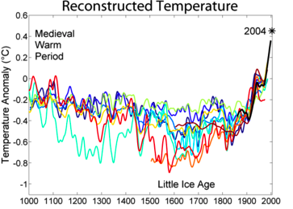

Slide 6
The way climate change is represented in the figures of the IPCC is aligned with the concept of messianic time described by Agamben in The Time That Remains and Derrida in Specters of Marx.

Slide 7
Important characteristics of messianic time
Not apocalyptic time
No messiahs
Disjuncture at the moment of the present
An ethical relationship to the past and future

Slide 8
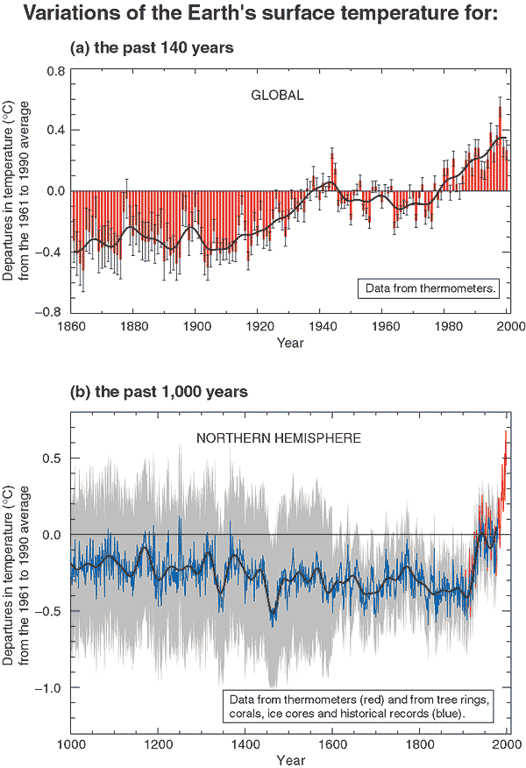
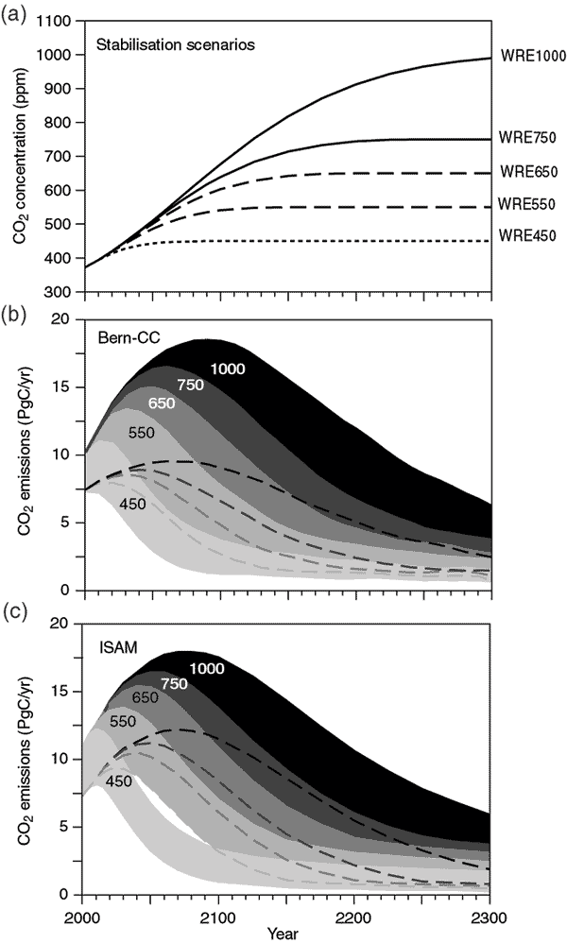
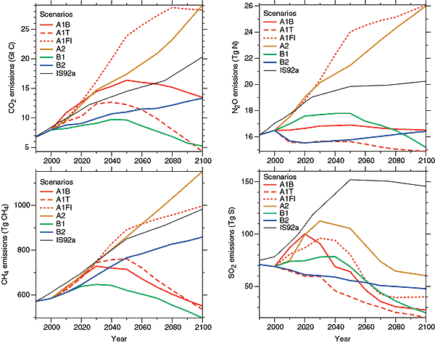
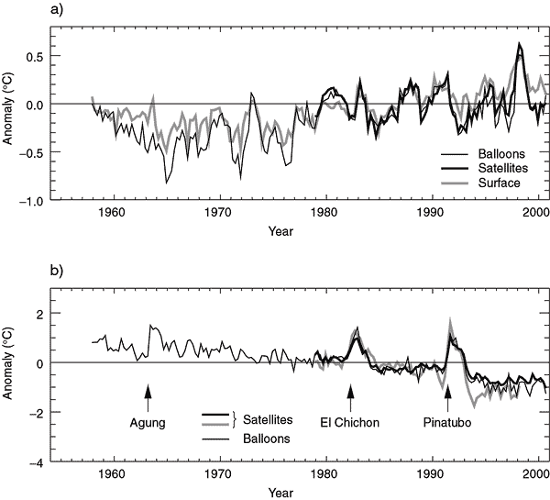
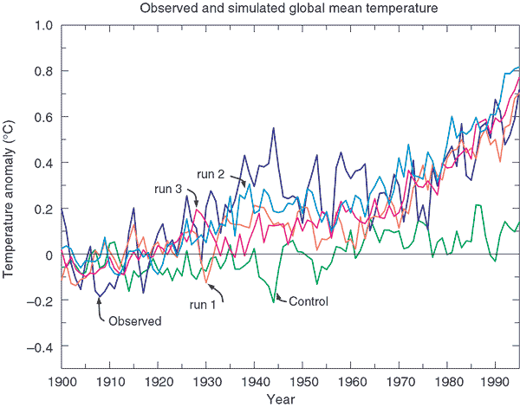
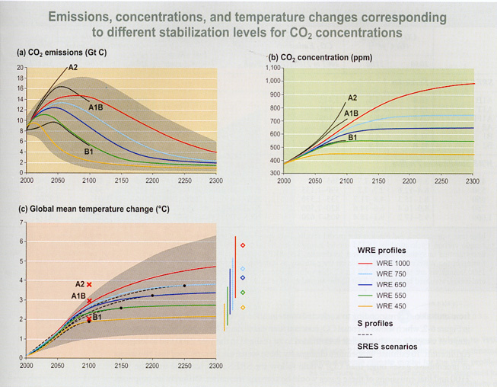
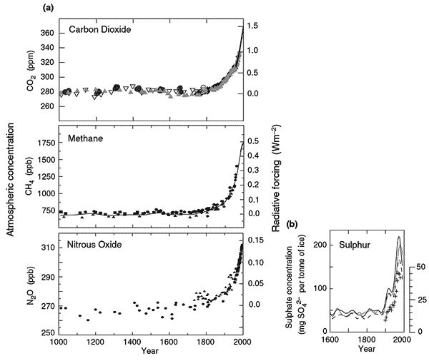
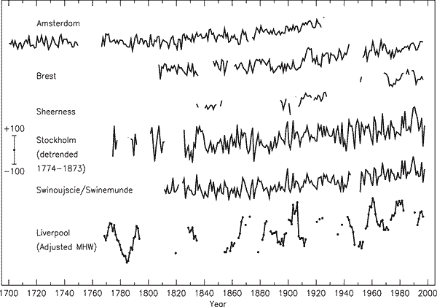
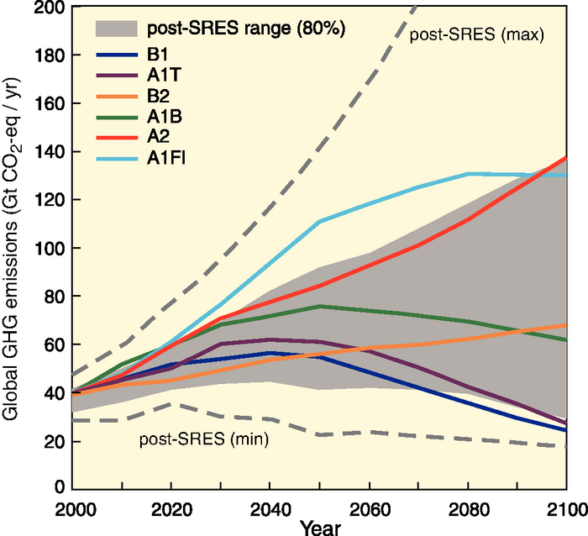
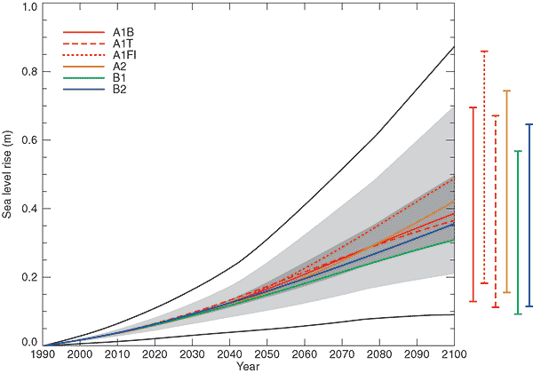
Disjuncture at the moment of the present
Hamlet: “The time is out of joint—O cursed spite, That ever I was born to set it right”

Slide 9
An ethical relationship to the past
“justice as incalculability of the gift and singularity of the an-economic ex-position to others. ‘The relation to others—that is to say, justice’” (Derrida, Spectres of Marx, 23).
Case study: the hockey stick graph

Slide 10
Figure 2.20: Millennial Northern Hemisphere (NH) temperature reconstruction (blue) and instrumental data (red) from AD 1000 to 1999, adapted from Mann et al. (1999). Smoother version of NH series (black), linear trend from AD 1000 to 1850 (purple-dashed) and two standard error limits (grey shaded) are shown.

Slide 12
Figure 2.20: Millennial Northern Hemisphere (NH) temperature reconstruction (blue) and instrumental data (red) from AD 1000 to 1999, adapted from Mann et al. (1999). Smoother version of NH series (black), linear trend from AD 1000 to 1850 (purple-dashed) and two standard error limits (grey shaded) are shown.

Slide 13
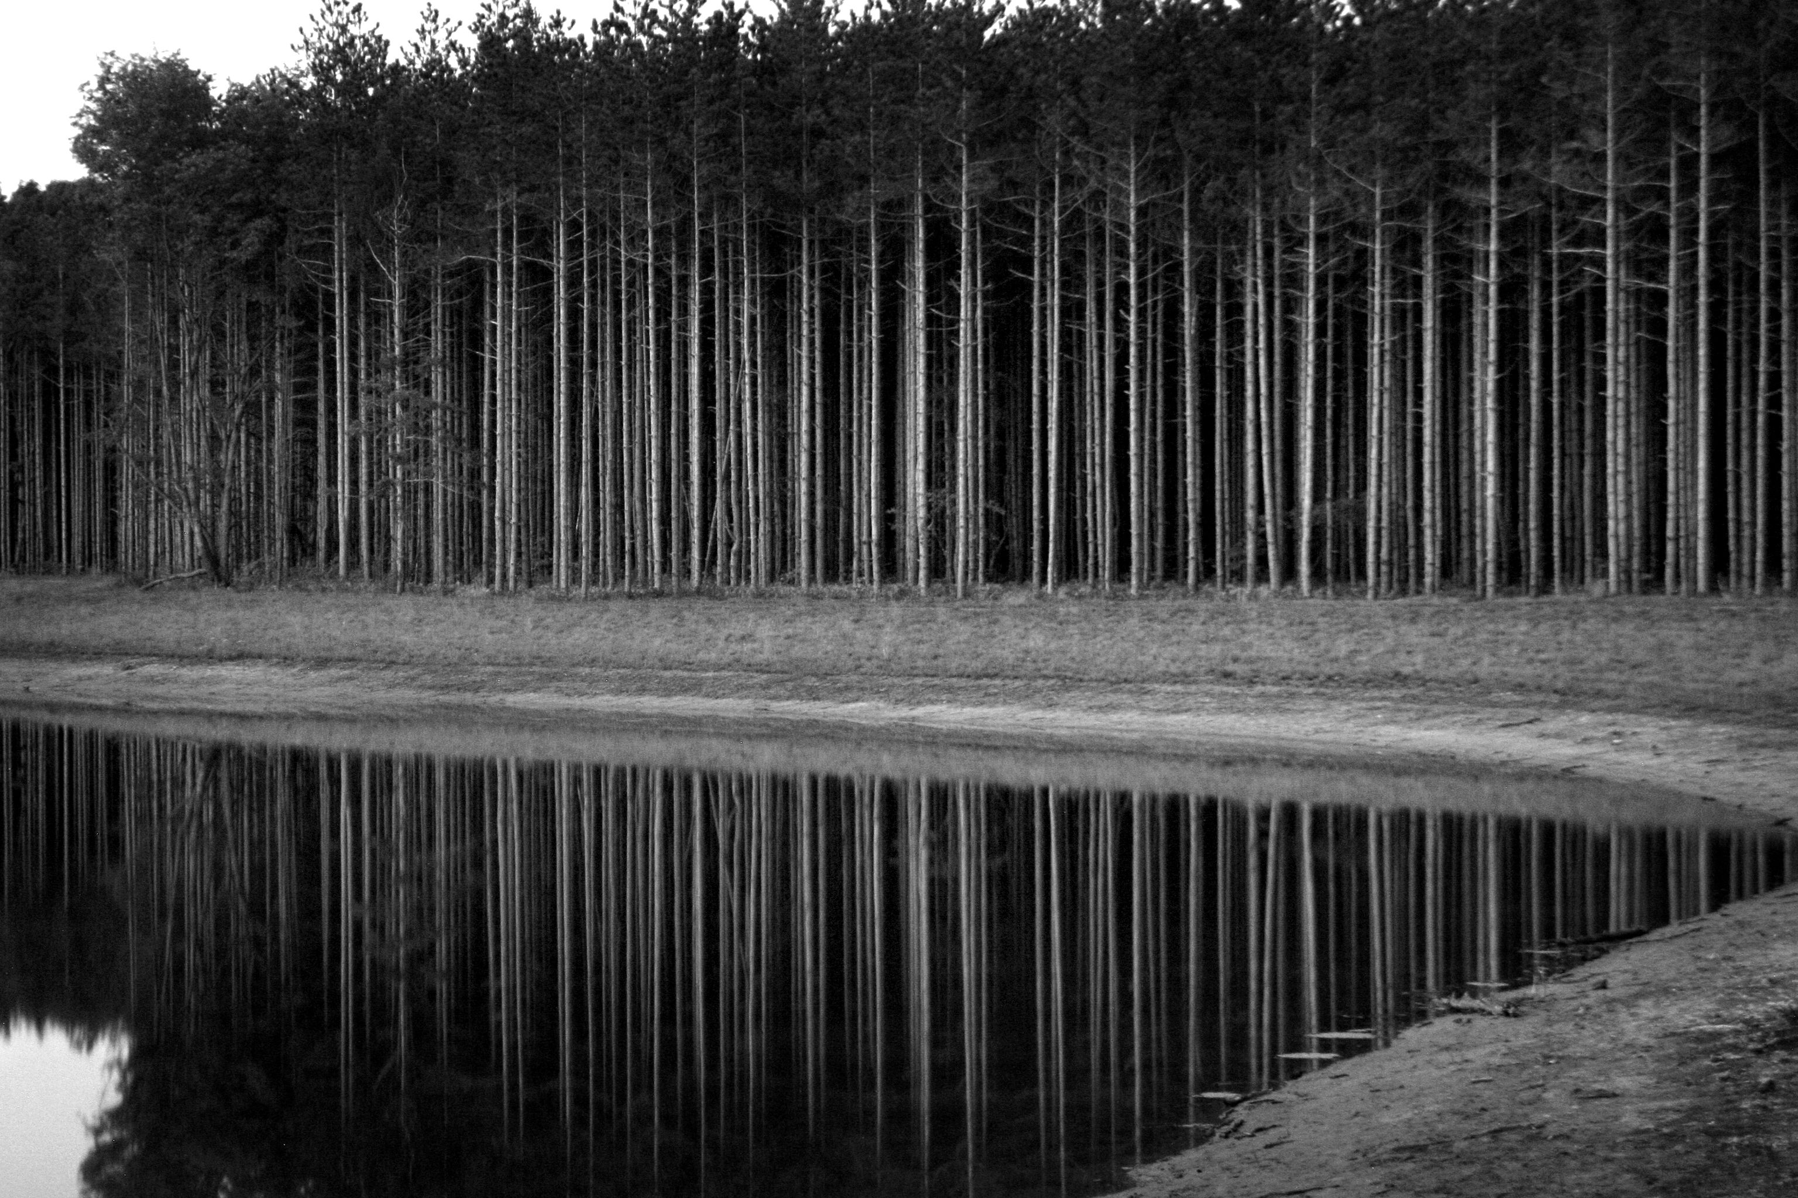

Slide 14
Figure 2.20: Millennial Northern Hemisphere (NH) temperature reconstruction (blue) and instrumental data (red) from AD 1000 to 1999, adapted from Mann et al. (1999). Smoother version of NH series (black), linear trend from AD 1000 to 1850 (purple-dashed) and two standard error limits (grey shaded) are shown.

Slide 16
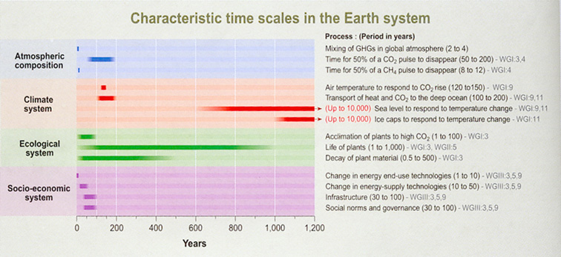

Slide 17
How do we use this in artistic representation of climate change?

Slide 18
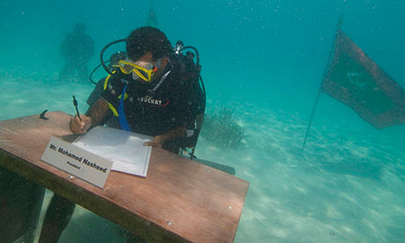

Slide 19
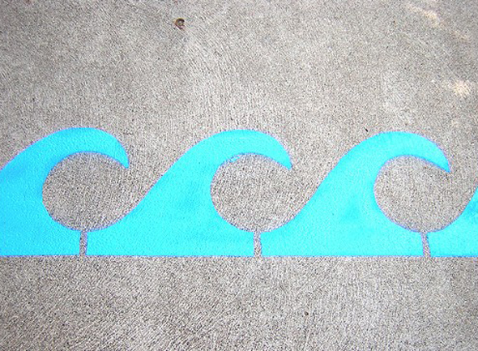
The Light Blue Line Project

Slide 20
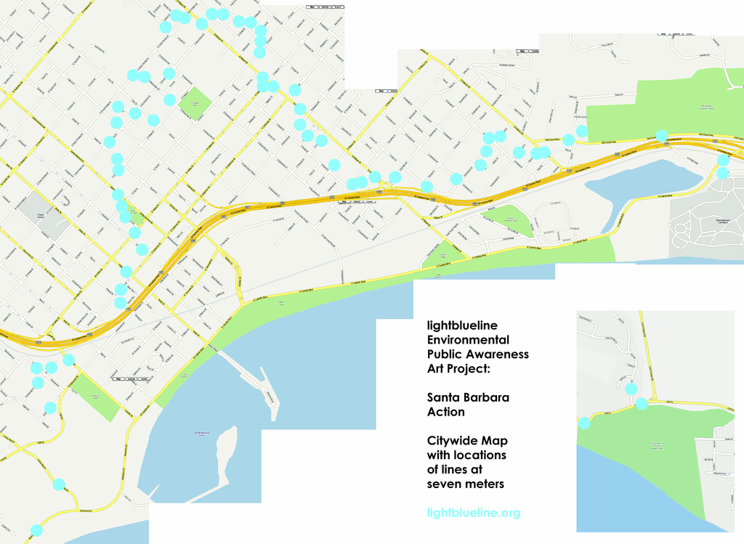
The Light Blue Line Project

Slide 22
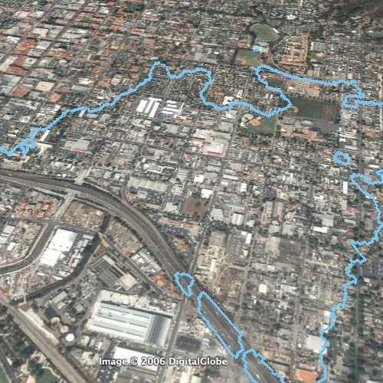

Slide 23
“Economic development is primarily regionally oriented and per capita economic growth and tchnological change more fragmented”
“convergent world,” “global solutions,” ”improved equity,” “population peaks mid century” Shared technology

Slide 24
SRES scenarios
SRES refers to the scenarios described in the IPCC Special Report on Emissions Scenarios (SRES, 2000). The SRES scenarios are grouped into four scenario families (A1, A2, B1 and B2) that explore alternative development pathways, covering a wide range of demographic, economic and technological driving forces and resulting GHG emissions. The SRES scenarios do not include additional climate policies above current ones. The emissions projections are widely used in the assessments of future climate change, and their underlying assumptions with respect to socio-economic, demographic and technological change serve as inputs to many recent climate change vulnerability and impact assessments. {WGI 10.1; WGII 2.4; WGIII TS.1, SPM}
http://www.ipcc.ch/publications_and_data/ar4/wg3/en/spm.html
The A1 storyline assumes a world of very rapid economic growth, a global population that peaks in mid-century and rapid introduction of new and more efficient technologies. A1 is divided into three groups that describe alternative directions of technological change: fossil intensive (A1FI), non-fossil energy resources (A1T) and a balance across all sources (A1B). B1 describes a convergent world, with the same global population as A1, but with more rapid changes in economic structures toward a service and information economy. B2 describes a world with intermediate population and economic growth, emphasising local solutions to economic, social, and environmental sustainability. A2 describes a very heterogeneous world with high population growth, slow economic development and slow technological change. No likelihood has been attached to any of the SRES scenarios. {WGIII TS.1, SPM}

Slide 25
A1. The A1 storyline and scenario family describes a future world of very rapid economic growth, global population that peaks in mid-century and declines thereafter, and the rapid introduction of new and more efficient technologies. Major underlying themes are convergence among regions, capacity building and increased cultural and social interactions, with a substantial reduction in regional differences in per capita income. The A1 scenario family develops into three groups that describe alternative directions of technological change in the energy system. The three A1 groups are distinguished by their technological emphasis: fossil intensive (A1FI), non-fossil energy sources (A1T), or a balance across all sources (A1B) (where balanced is defined as not relying too heavily on one particular energy source, on the assumption that similar improvement rates apply to all energy supply and end-use technologies).
A2. The A2 storyline and scenario family describes a very heterogeneous world. The underlying theme is self-reliance and preservation of local identities. Fertility patterns across regions converge very slowly, which results in continuously increasing population. Economic development is primarily regionally oriented and per capita economic growth and technological change more fragmented and slower than other storylines.
B1. The B1 storyline and scenario family describes a convergent world with the same global population, that peaks in mid-century and declines thereafter, as in the A1 storyline, but with rapid change in economic structures toward a service and information economy, with reductions in material intensity and the introduction of clean and resource-efficient technologies. The emphasis is on global solutions to economic, social and environmental sustainability, including improved equity, but without additional climate initiatives.
B2. The B2 storyline and scenario family describes a world in which the emphasis is on local solutions to economic, social and environmental sustainability. It is a world with continuously increasing global population, at a rate lower than A2, intermediate levels of economic development, and less rapid and more diverse technological change than in the A1 and B1 storylines. While the scenario is also oriented towards environmental protection and social equity, it focuses on local and regional levels.

Slide 26
